Slide 1
AEM Solr integration

Slide 2

Solr
Solr is a standalone enterprise search server with a REST-like API. You put documents in it (called "indexing") via JSON, XML, CSV or binary over HTTP. You query it via HTTP GET and receive JSON, XML, CSV or binary results.

Slide 3
Query and Performance
REST interfaces provide for easy integration with any language.
Multiple scoring (similarity) approaches allow for easy experimentation and relevance tuning.
Near to Real Time (NRT) search and indexing allow to update and receive data immediately.
A multitude of smart caching options enable exacting control over repetitive results a breeze.

Slide 4
Scaling
Add and remove compute capacity as needed, while letting Solr do the dirty work of load balancing and more.
Advanced transaction log, replication and failover capabilities help minimize data loss while still serving results.

Slide 5
Plugins and Extensions
Language detection
Indexing rich content (e.g. PDFs, Word)
Clustering
Data-import
UIMA
Apache Velocity

Slide 6
User-experience features
Pagination and sorting
Faceting
Autosuggest
Spell-checking
Hit highlighting
Geospatial search

Slide 7

Tested and proven

Slide 8
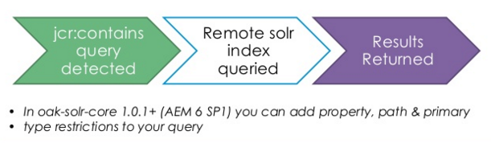
Flow

Slide 9
Types of Solr that Oak uses
Embedded Solr
Primarily used for development work. The solr instance runs within AEM and can be configured similar to remote instance.
Remote Solr
Used for non-development, production level environments. Typically these instances take advantage of fault tolerant features of the Solr cloud. In many cases, existing solr instances are used.

Slide 10
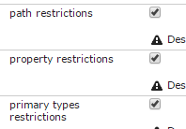
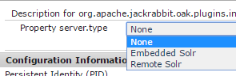
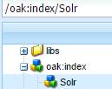
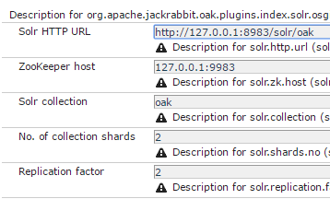
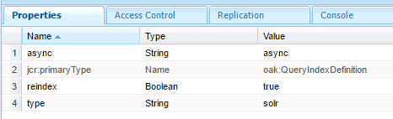
Solr Configuration in AEM
Oak Solr indexing / search
Oak Solr server provider
Oak Solr remote server

Slide 11
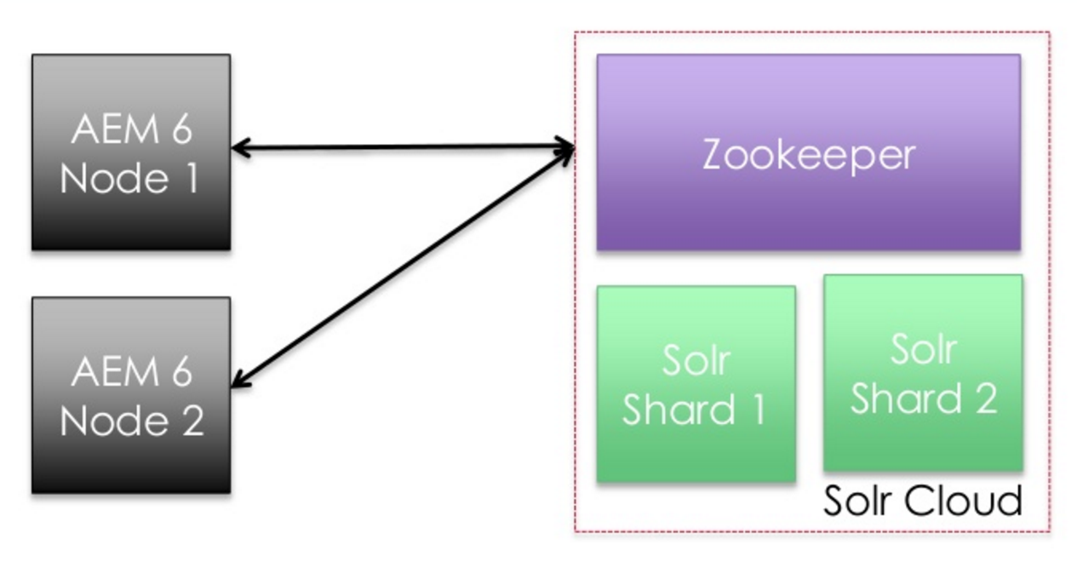
Solr Conceptual Architecture with SolrCloud

Slide 12
External Search Platform
Supports more then one content sources
Provide more advanced search features (faceted search, geospatial search, autosuggest, hit highlighting)

Slide 13
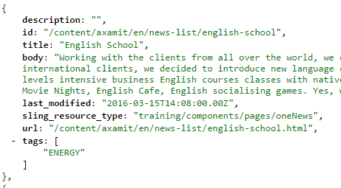
Solr Update Handler Pattern
1. Implement servlet to generate same output as a Solr’s update handler (i.e., JSON).
2. Create script to invoke servlet (curl) and save response to file system.
3. Update index by posting (curl) documents to Solr request handler (i.e., JsonUpdateRequestHandler).
4. Call script from scheduler (cron).

Slide 14
Solr Update Handler Pattern
# Request from CQ a dump of the content in the Solr JSON update handler
curl -s –u admin:admin -o news.json http://localhost:4502/apps/axamit/solr/updatehandler?type=/training/components/pages/oneNews
# Post the local JSON file that was saved in step 1 to Solr and commit
curl http://localhost:8888/solr/axamitCollection/update?commit=true -H "Content-Type: application/json" --data-binary @news.json
Good for initial indexing of content (high index latency)

Slide 15
Event Listener Pattern
1. Wrap SolrJ as an OSGi bundle.
2. Implement listener (JCR Observer, Sling eventing or workflow*) to listen for changes to desired content.
3. On event, trigger appropriate SolrJ index call (add/update/delete).
Good for real-time content indexing (low index latency)

Slide 16
Resources
http://www.aemsolrsearch.com/#/
http://lucene.apache.org/solr/
https://docs.adobe.com/docs/en/aem/6-1/deploy/platform/queries-and-indexing.html#par_title_5
https://docs.adobe.com/content/docs/en/aem/6-1/deploy/best-practices/best-practices-for-queries-and-indexing.html#Solr%20Indexing

